Slide 1
Halloween is Here!

Slide 2
Fly, fly, fly little bats.

Slide 3
Halloween is here!

Slide 4
Crawl, crawl, crawl
little spiders.

Slide 5
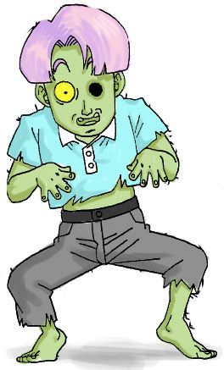
Halloween is here!

Slide 6
Stomp, stomp, stomp
little monsters.

Slide 7
Halloween is here!

Slide 8
Creep, creep, creep
little cats.

Slide 9
Halloween is here!

Slide 10
Dance, dance, dance
little skeletons.

Slide 11
Halloween is here!

Slide 12
Float, float, float
little ghosts.

Slide 13
Halloween is here!

Slide 14
This powerpoint was kindly donated to www.worldofteaching.com
http://www.worldofteaching.com is home to over a thousand powerpoints submitted by teachers. This is a completely free site and requires no registration. Please visit and I hope it will help in your teaching.

